Slide 1

A Coarse Study of Effect of Music on Mental Health

Slide 2
Disclaimer
The content herein is solely for education purpose in practice of IT data analytics under the introductory course of Christian Action based on dataset available in public site. None of the information shared herein should be used as advice, consultation or assistance of any kinds of mental treatment or any profession. The authors, teachers and Christian Action should owe no responsibility to any consequence in direct or indirect relation to the use of information in this material and derived presentation. Should there be of any mental condition, unpleasant condition or support need, please approach professionals, entrusted physicians and trusted persons.

Slide 3

Agenda
Background
Approach
Introduction to the dataset
Data Cleansing
Analysis and Implications
Challenges and Limitations
Conclusion

Slide 4
Background
Year | Patients with Mental Illness
2011 – 2012 | 187,000
2015 – 2016 | 220,000
2019 – 2020 | 270,700
2023 – 2024 | 305,700
Mental health as escalating public health issue in HK
Music known to be part of everyday life
Could music be a way to mediate mental health problem?
Notes:
https://app7.legco.gov.hk/rpdb/en/uploads/2024/ISSH/ISSH11_2024_20240531_en.pdf
https://www.healthbureau.gov.hk/download/press_and_publications/otherinfo/180500_mhr/e_mhr_full_report.pdf
https://www.frontiersin.org/journals/psychology/articles/10.3389/fpsyg.2021.647756/pdf

Slide 5
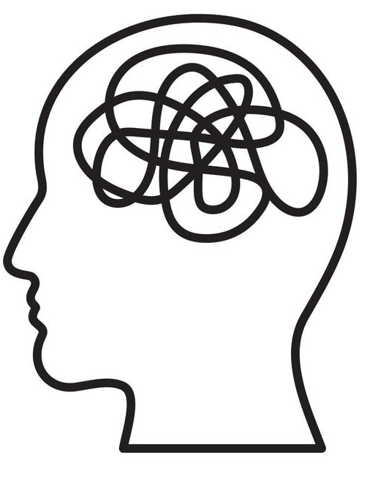




Approach
Problem:
Mental health issue in society
Hypothesis:
There is relation between Music and Mental Health
Research:
Look for recent survey and open data on the subject
EDA and Cleansing:
Understanding the dataset and spot out the potential data problem
Analysis and Implication:
By data analytics and visualization tool, draw valuable observation and implications
Future Improvement:
Evaluate and embrace feedback, for betterment

Slide 6

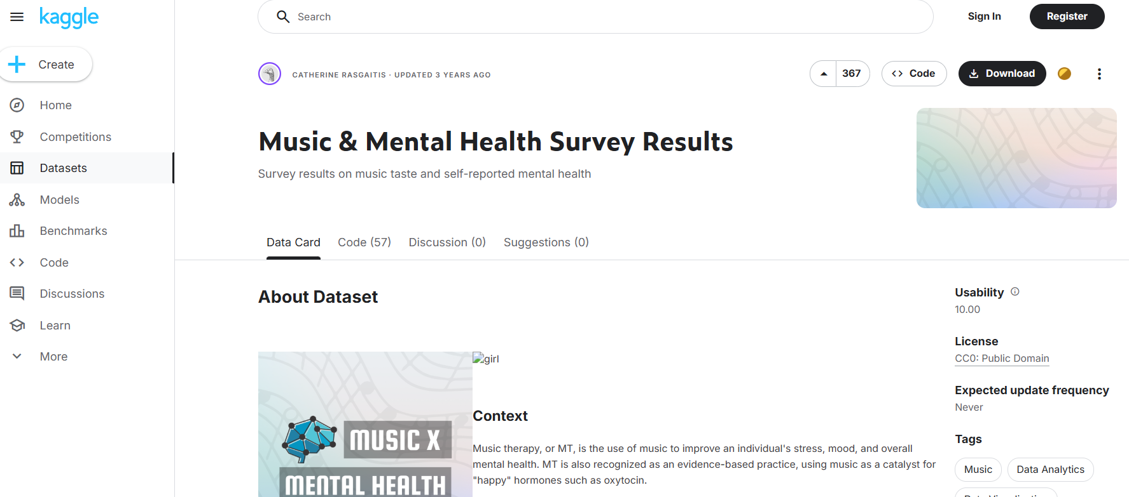
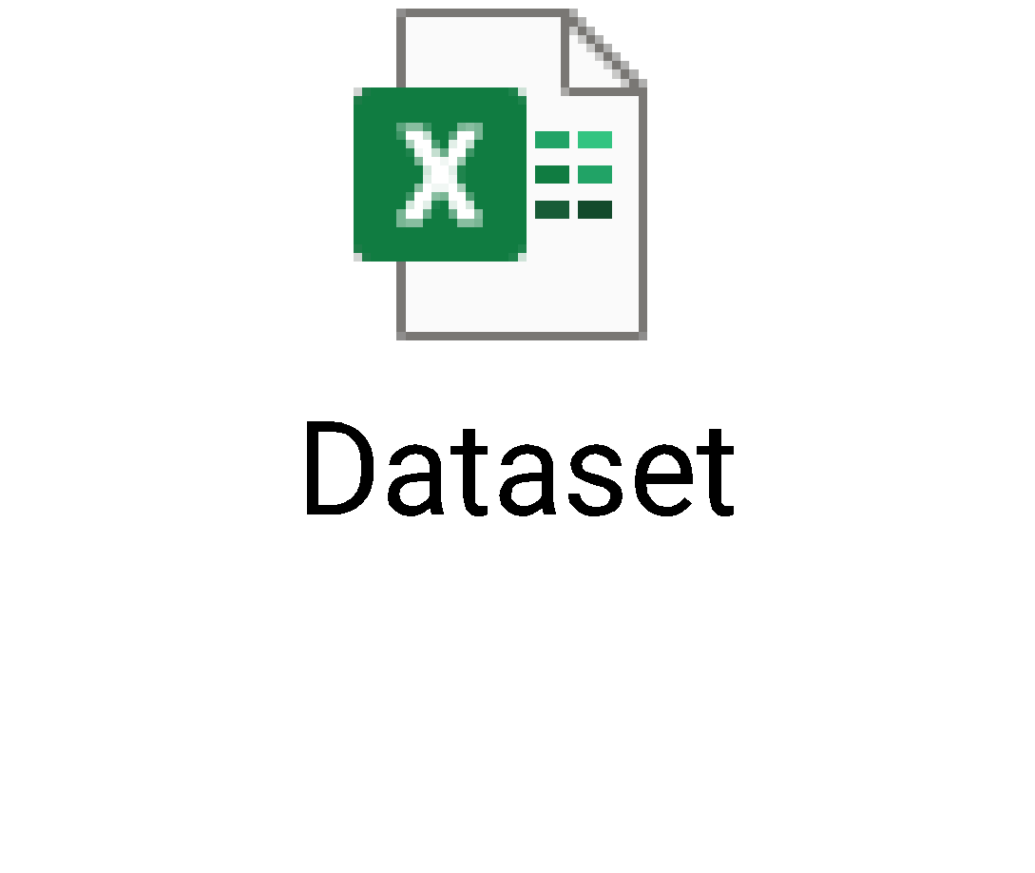
Introduction of Dataset
Data source from Kaggle:
https://www.kaggle.com/datasets/catherinerasgaitis/mxmh-survey-results/data

Slide 7
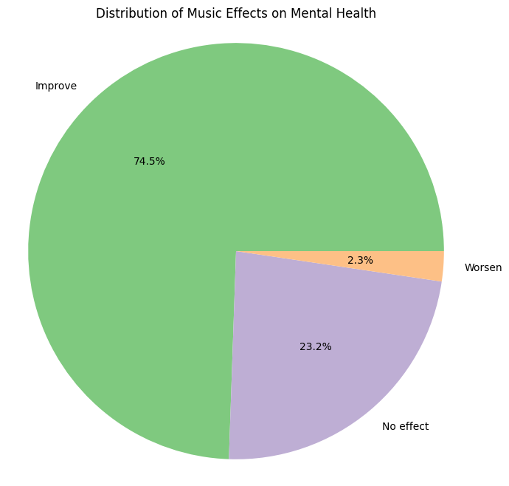
Dataset Characteristics
Univariate Analysis
First sight :
Large proportion showing Effect of Music (Both Improve and Worsen) on Mental Health: >75%
Second insight:
Majority in Improvement found in Mental Health with Music
Hypothesis matched
🡺 Worth further study

Slide 8
Dataset Characteristics
- Variable Identification (Data Type)
Variable Categories | Variable Type | Variables | Data Type
Qualitative (Categorical) | Nominal | Timestamp | String (Datetime)
 |  | Primary streaming service | String
 |  | While working (Yes/No) | Boolean
 |  | Instrumentalist (Yes/No) | Boolean
 |  | Composer (Yes/No) | Boolean
 |  | Fav genre | String
 |  | Exploratory (Yes/No) | Boolean
 |  | Foreign languages (Yes/No) | Boolean
 | Ordinal | Frequency of 16 music genres | String
 |  | Mental Health Disorder Ranking (Anxiety, Depression, Insomnia ,OCD) | Integer
 |  | Music effects | String
Quantitative (Numerical) | Discrete | BPM | Integer
 | Continuous | Hours per day | Integer
 |  | Age | Integer

Slide 9
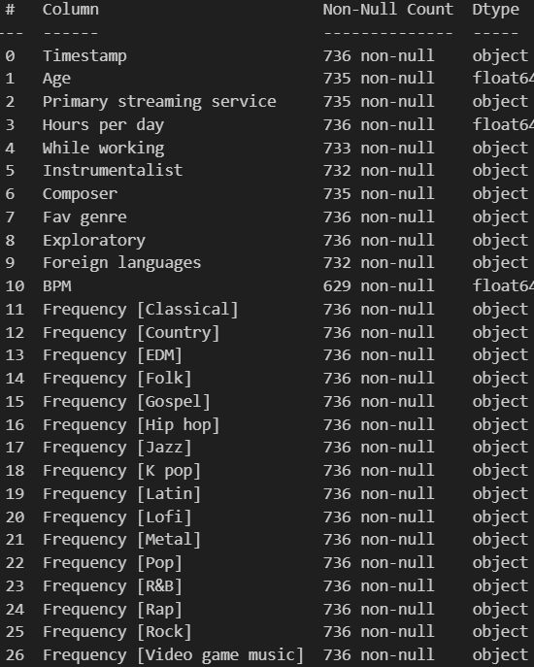
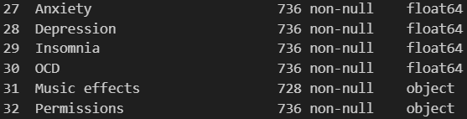
Dataset Characteristics
Raw: 700+ rows * 30+ columns
Data is semi-structural with potential handicap
EDA and cleansing required
Good for practice of the learned skill in this course
Potential Data Problem:
Null value
Redundant / Irrelevant data
Erroneous / Non-sense input

Slide 10
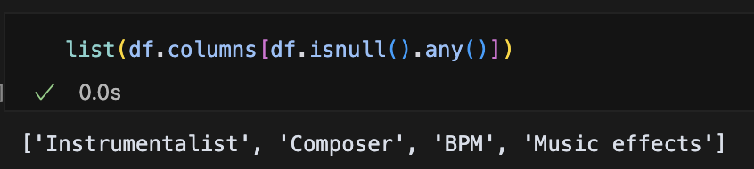
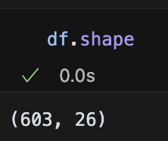
Data Cleansing – Null Value
4 columns contain null values
Data Cleansing
A 603 × 26 dataset is used in this study

Slide 11
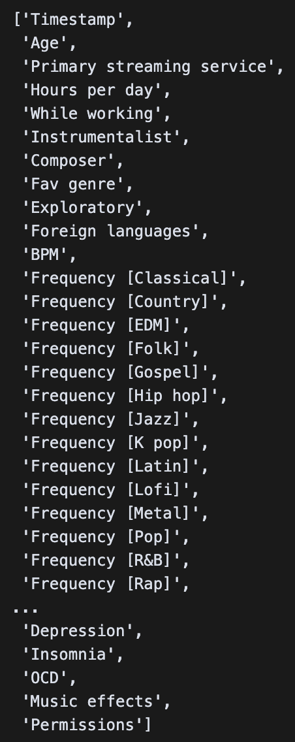
Data Cleansing – Irrelevant Data
Columns in Focus (Scope of this study) | Irrelevant Data | Data that could be studied in future
Hours per day Instrumentalist Composer Fav genre BPM Frequency of 16 music genres Anxiety Depression Insomnia OCD Music effects | Timestamp Primary streaming service Permission | While working Age Exploratory Foreign languages

Slide 12
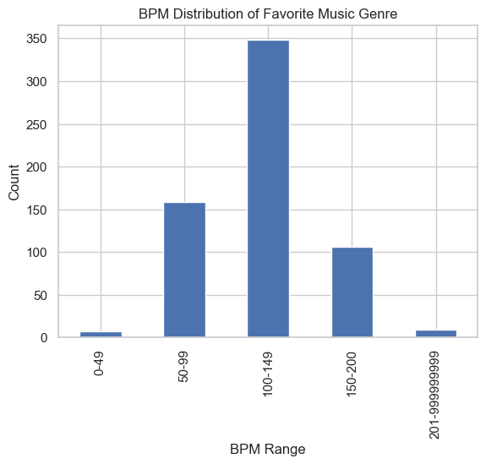
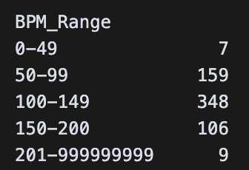
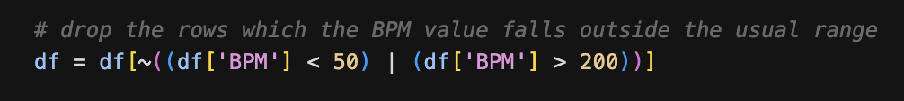
Data Cleansing – Erroneous Data/ Non-sense input
Univariate Analysis
Nonsense / erroneous / meaningless data includes:
  Hours (of music playing) = 0
  BPM(Beat Per Minute) < 50 or > 200
Data cleansing for BPM:
Define the standard BPM range for music
Usual music BPM (Beat Per Minute) range: 50 – 200

Slide 13
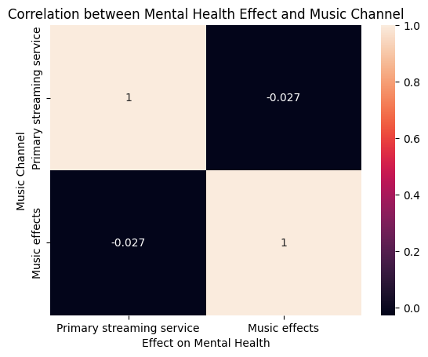

Data Cleansing – Correlation Analysis
Bivariate Analysis
DOUBT: Relation between the choice of Music Channel (col. Primary streaming service) and its effect on Mental Health (col. Music effects)
A bivariate analysis with heatmap to study the correlation of the two
Finding: Correlation near Zero
An advanced analysis in next slide…

Slide 14
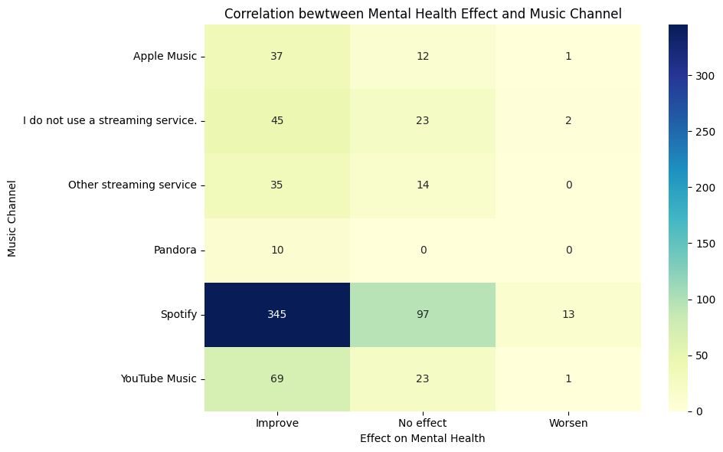
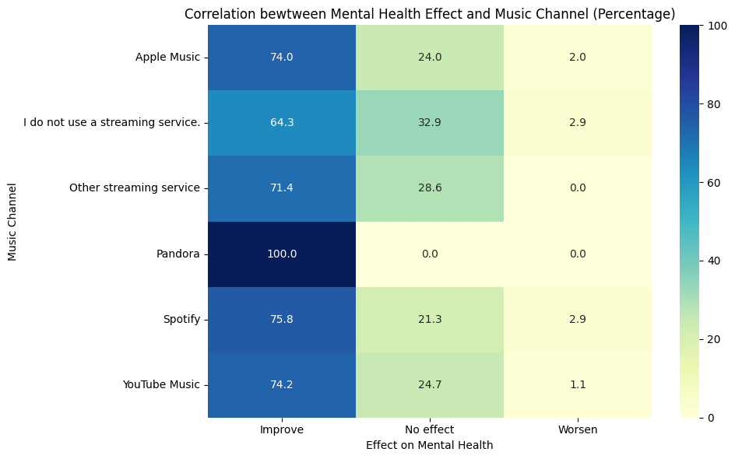
Data Cleansing – Correlation Analysis (Adv)
Bivariate Analysis
Left: (vertically) not much different except Spotify
Advantage: direct comparison between Channels
Defect and bias: based on Count of choice (e.g. Spotify is the most popular channel)
Right: (vertically) not much different except Pandora
Advantage: percentage calculation eliminates population bias
Defect and bias: sampling size problem (e.g. size of Pandora is the least, 10 only

Slide 15
Data Cleansing – Correlation Analysis (Adv)
Bivariate Analysis
Conclusion: The relation is not obvious. This attribute will be excluded from analysis.
Left: (vertically) not much different except Spotify
Advantage: direct comparison between Channels
Defect and bias: based on Count of choice (e.g. Spotify is the most popular channel)
Right: (vertically) not much different except Pandora
Advantage: percentage calculation eliminates population bias
Defect and bias: sampling size problem (e.g. size of Pandora is the least, 10 only

Slide 16
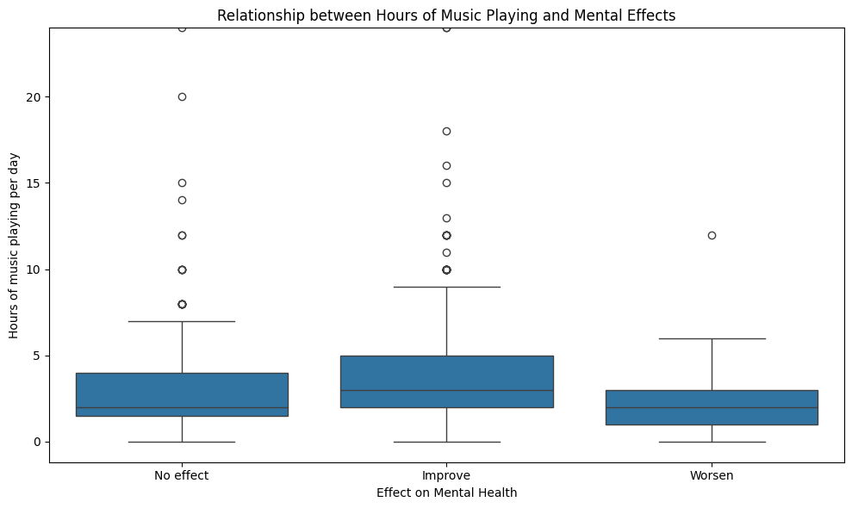
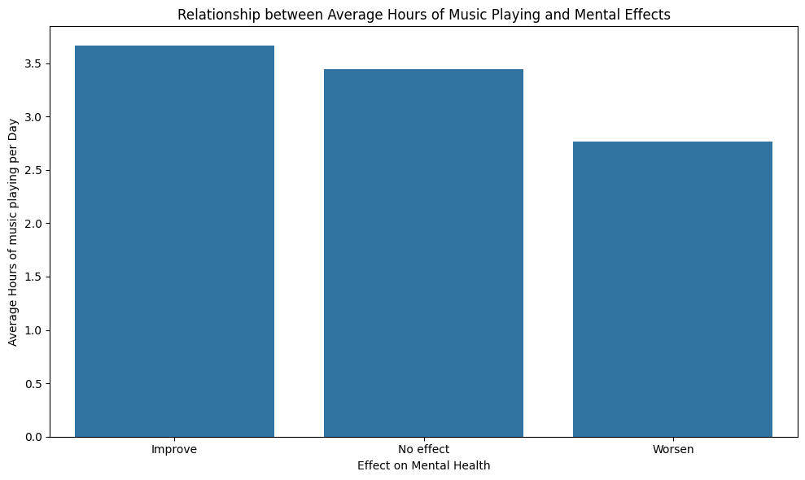
Bivariate Analysis and Implications
- Effect of Music Playing Duration on General Mental Health Improvement
(appear to be) Mental Improver has a tendency to listen to music around 3.5 hours
Data is diverse and boundary is vague
The relation is not proportionate or linear
No obvious conclusion can be drawn simply from bivariate analysis on Mental Health Improvement and Music Playing Hour
🡺 A deeper and Multivariate Analysis is required...

Slide 17
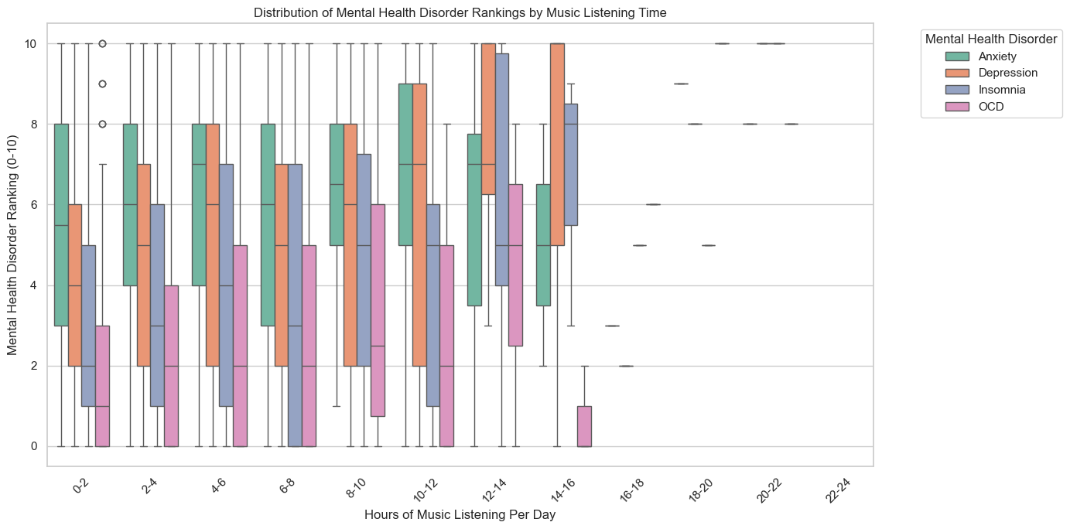
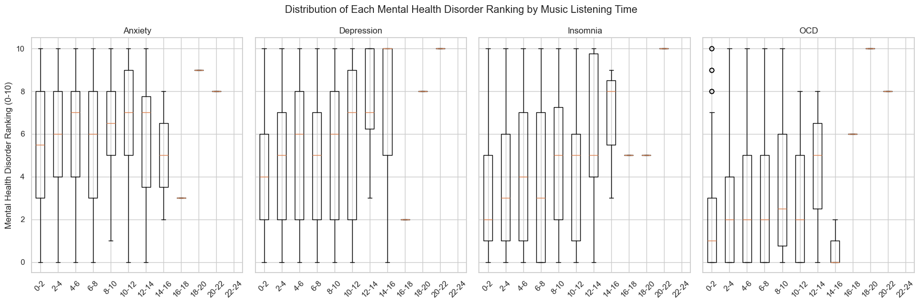
Multivariate Analysis and Implications
- Effect of Music Playing Duration on Mental Health Disorder
Anxiety & Depression:
↑ music listening ↑ symptoms
Insomnia:
steady rise in symptoms with more music
OCD: remains lower overall, less significant when compared to the other conditions
Linear correlation:
↑ Music listening time
↑ Mental Health Disorder Ranking
Outliner:16+ hours/day, smaller sample sizes
Findings: correlation that individuals struggling more with mental health may be using music as a coping mechanism, leading to higher listening times.

Slide 18
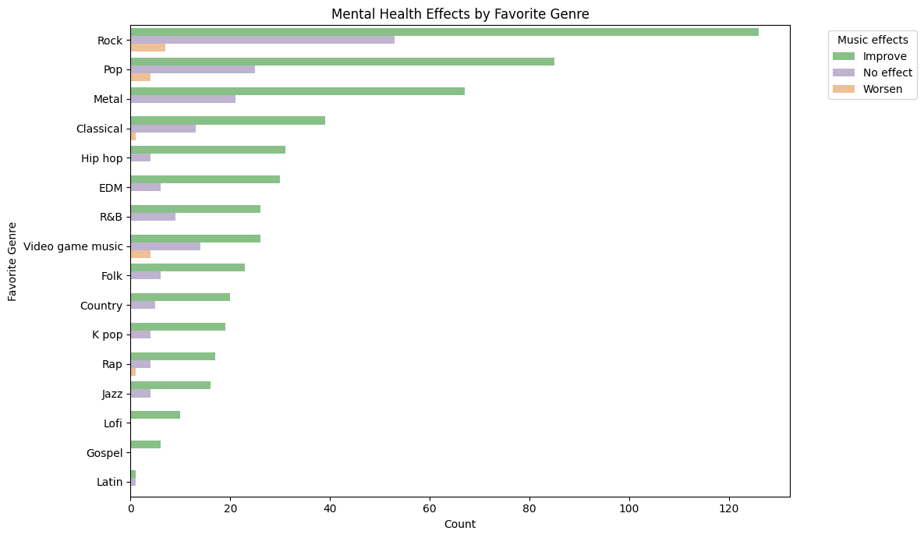
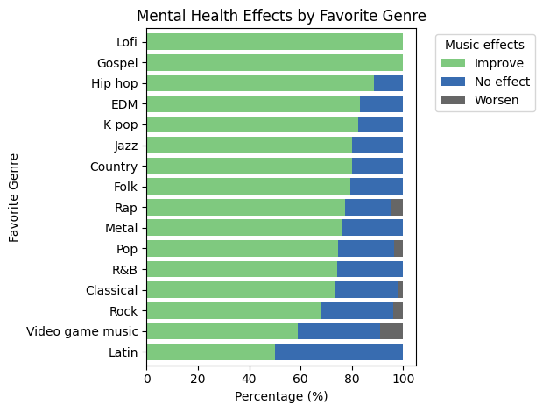
Bivariate Analysis and Implications
- Relation of Music Genre and its Effect on General Mental State
Actual count of Music Effect over Genre
(Apparently) Rock yields greatest Improvement effect
(BUT) Rock also yields greatest Worsen or Nil Effect
Percentage distribution of Music Effect over Genre
(Apparently) Lofi and Gospel are most encouraging
(BUT) Popularity / Sampling size problem

Slide 19
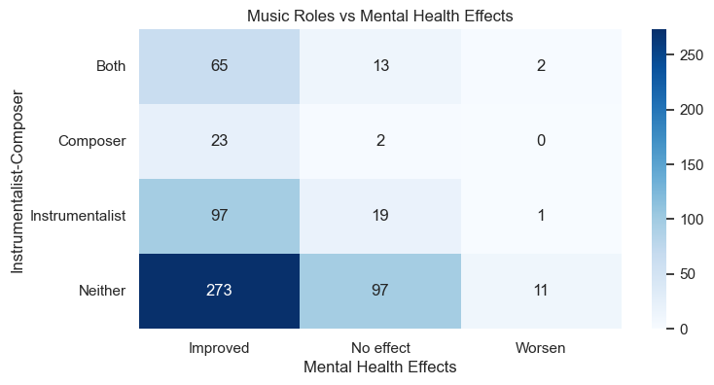
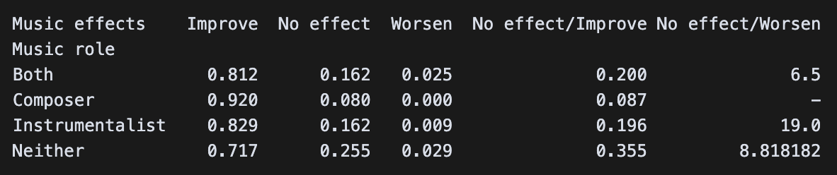
Multivariate Analysis and Implications
- Effect of Music Engagement (Instruments / Composition) on Mental Health
4 combinations of music engagement
  Instrumentalist
  Composer
  Both
  Neither (Pure music listener)
The majority agrees music improve mental health
Ratio of No effect / Improve
  Composer > Instrumentalist> Both > Neither
  Sampling size problem

Slide 20
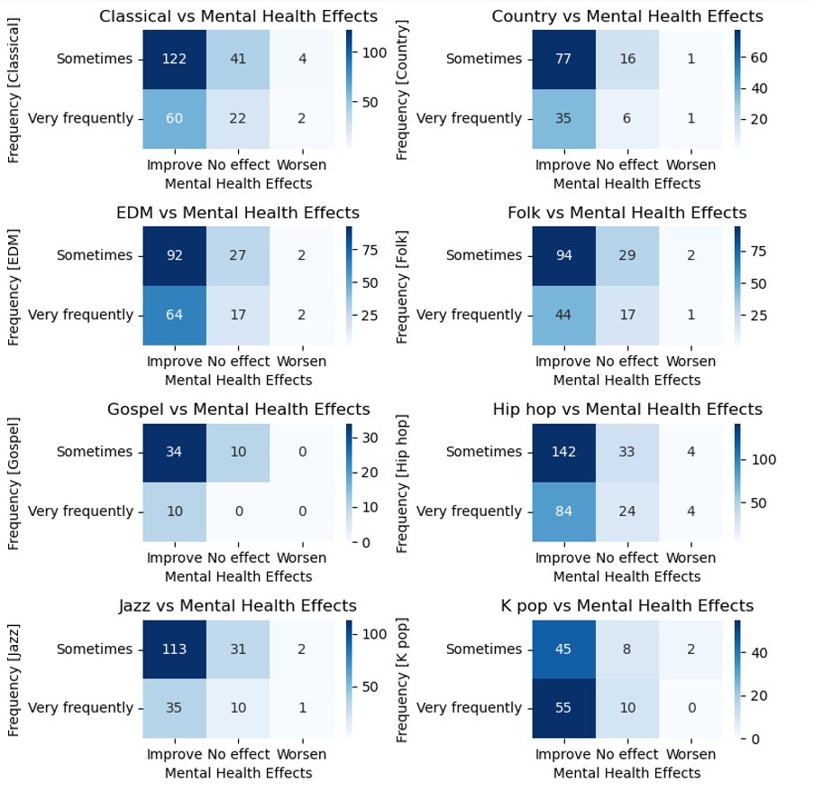
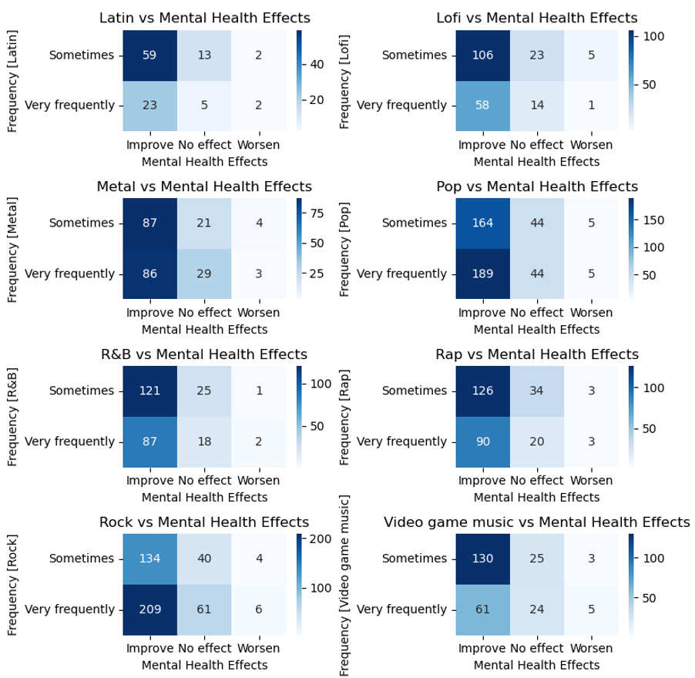
Bivariate Analysis and Implications
- Relation of Music Genre Playing Frequency and Mental State

Slide 21
Challenges and Limitations
Challenges and Limitations | Possible Improvements
No control group | Try to make use of sample with 0 hours of music listening
Biased Data (Listening frequency, rankings) | Deeper analysis to list out outliers for consideration of exclusion
Difficulty in standardization (Listening hours) | To research on average hours of playing, define the normal range in consideration of 25 to 75 %tile
Lack of longitudinal data | Require clarification from survey inspector / designer
No pre/post comparison of how music affect the four mental health rankings | ditto
Cannot determine which music genre most impacts mental health | Expand multivariate analysis, e.g. Fav genre X Freqency of genre X Effect

Slide 22
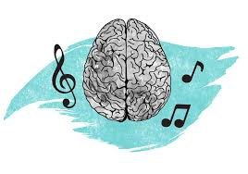
Conclusion
There is certain relation between Music and Mental Health
  Both Music Engagement and Music Listening
It worths further study the effect in between
  Music → Mental
  Music ← Mental
  Causal relation apart from correlation
Rooms of improvement:
  Coding style
  Wider perspective in analysis
  Other data attributes

Slide 23
Reference
https://www.kaggle.com/datasets/catherinerasgaitis/mxmh-survey-results/data
https://app7.legco.gov.hk/rpdb/en/uploads/2024/ISSH/ISSH11_2024_20240531_en.pdf
https://www.healthbureau.gov.hk/download/press_and_publications/otherinfo/180500_mhr/e_mhr_full_report.pdf
https://www.frontiersin.org/journals/psychology/articles/10.3389/fpsyg.2021.647756/pdf
https://www.ifpi.org/wp-content/uploads/2023/12/IFPI-Engaging-With-Music-2023_full-report.pdf
https://bora.uib.no/bora-xmlui/bitstream/handle/1956/17222/Master.pdf?sequence=1&isAllowed=y

